Slide 1

Online Assignment Submission
Programme of Study: Masters Business Analytics
Module: 38158 LM Data Management Strategies and Technologies
Assignment Title: Group Presentation
Group Number: 16
Student ID Numbers: 2684858,
Date and Time of Submission:
22/02/2024 6:00am
Note: This cover slide is not included in any slide/word count.
By submitting your work online you are confirming that your work is your own and that you understand and have read the University’s rules regarding plagiarism and the consequences that will arise should you submit plagiarised work.

Slide 2
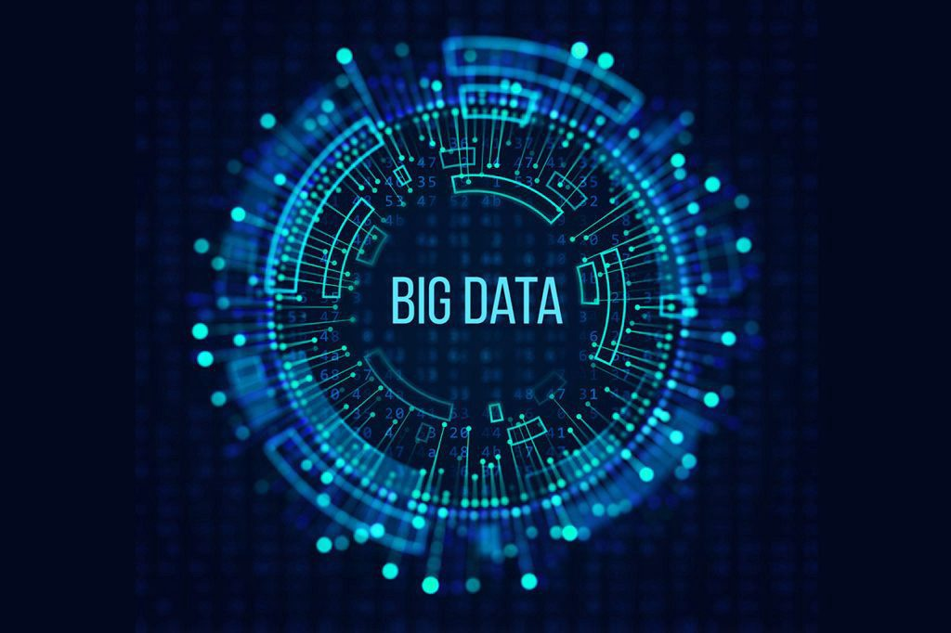
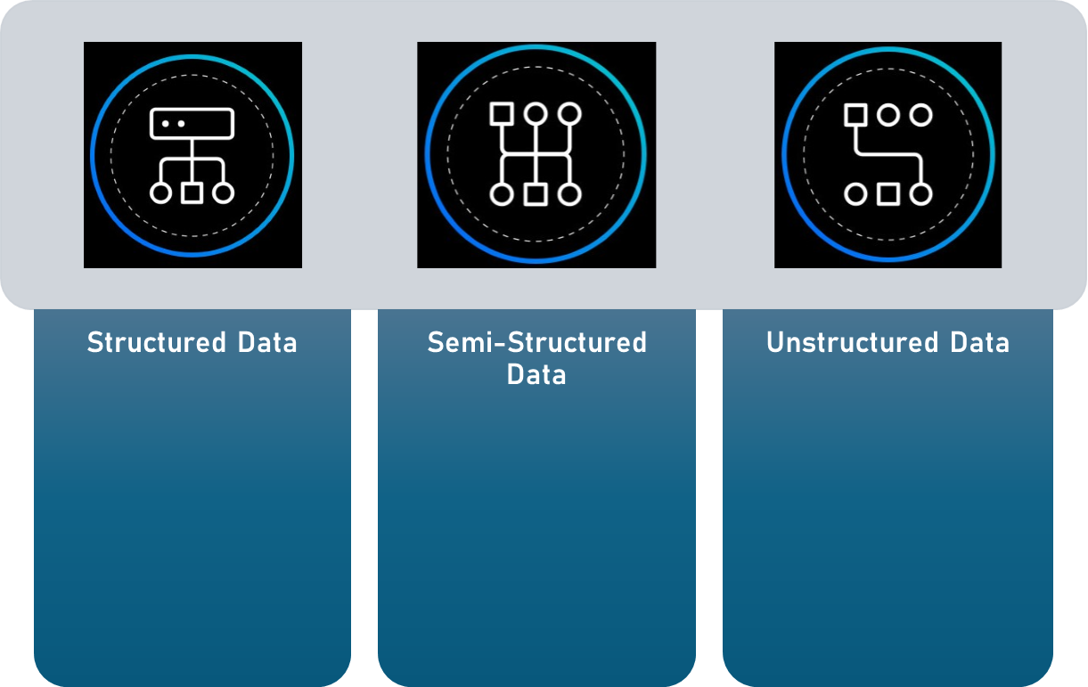









What is Big Data?
Massive Petabytes, Megabytes of information from multiple internal and external sources collected in datasets.
This data could be in
ID Code in Databases
Numerical Data Google Sheets
Star Ratings
Emails by Inbox, Sent, Draft
Tweets Organised by Hashtags
Folders Organized by topic
Media, Posts, Emails, Online Reviews
Videos, Images
Speech, sounds
Source: https://monkeylearn.com/blog/semi-structured-data/

Slide 3
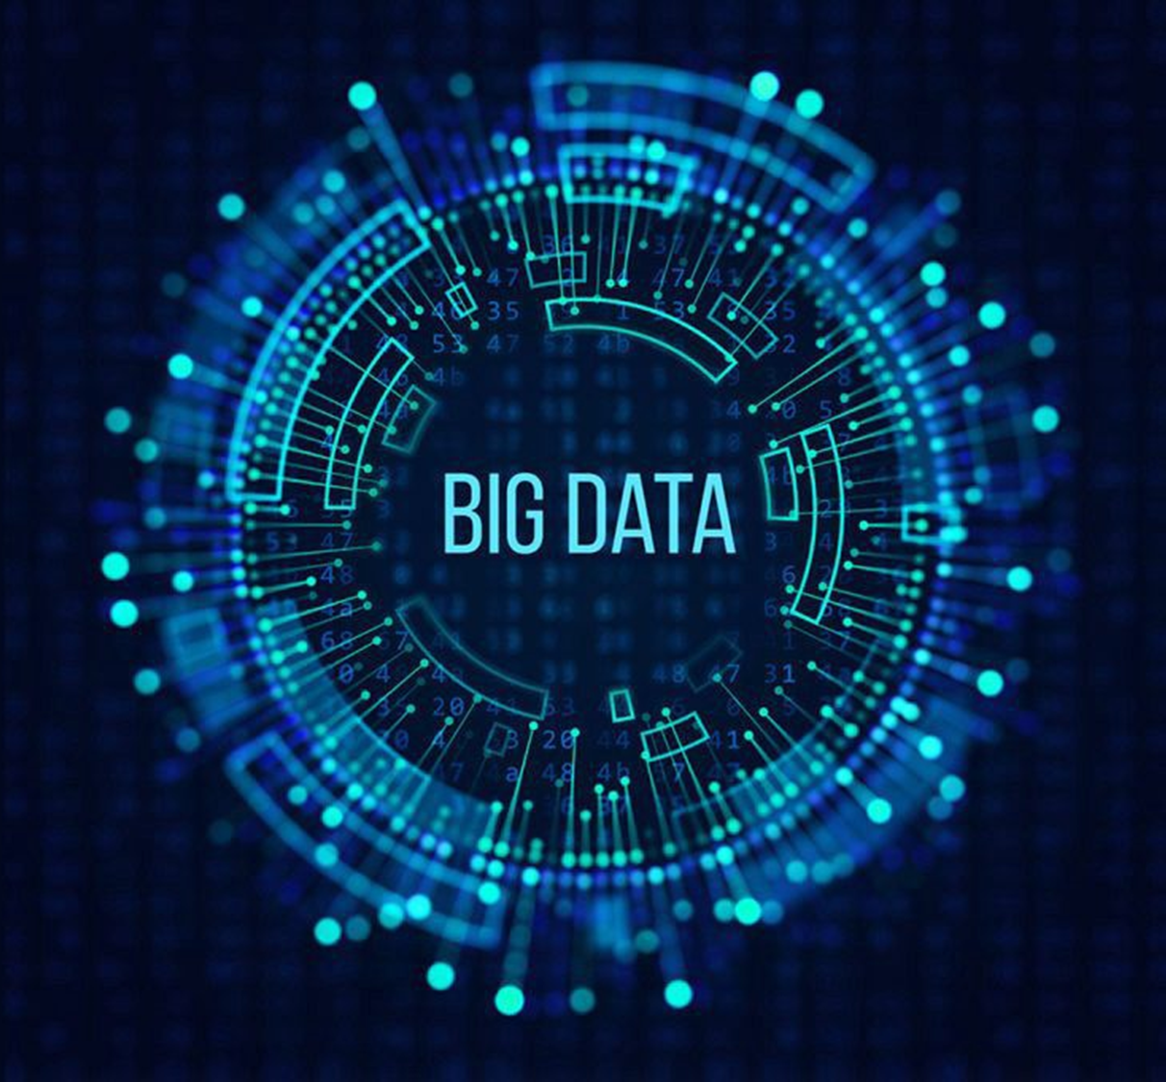
What is Big Data Technology?
Big data technology is used across almost every industry to:
Draw Insights: Analyse patterns and trends.
Perform Analytics: Understand user behavior, market dynamics, and more.
Train Artificial Intelligence and Machine Learning Models: Improve predictions and decision-making.
Make Data-Driven Business Decisions: Optimize processes and strategies.
Notes:
3

Slide 4
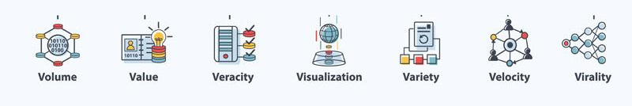
The 6V’s of Big Data
1. Volume
Involves dealing with massive amounts of data generated continuously.
Example: The New York Stock Exchange generates about one terabyte of new trade data per day.
2. Velocity
Real-time data flow, where information is generated, processed, and transformed rapidly.
Example: Google handles over 3.5 billion searches per day, and facebook's user base grows by
approximately 22% each year
3. Variety
Includes diverse data types and sources (structured, semi-structed, and unstructed).
Examples:
Structured data: Organized data (e.g., databases).
Unstructured data: No fixed format (e.g., text, images).

Slide 5
The 6V’s of Big Data
4. Veracity:
Refers to the trustworthiness and quality of data.
Importance: Ensuring data accuracy is crucial for reliable insights.
5. Value:
Big data must be converted into something valuable to drive business decisions.
Example: Turning raw data into actionable information creates value.
6. Variability
Deals with the inconsistency of data due to disparate sources and types.
Importance: Handling diverse data requires adaptable tools and techniques.

Slide 6
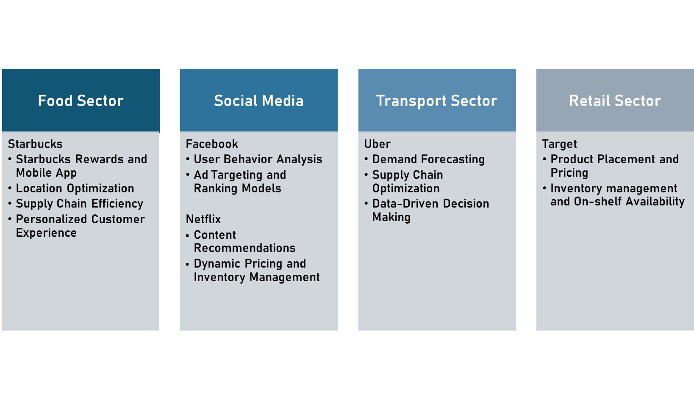
Big Data Technology in Various Sectors

Slide 7
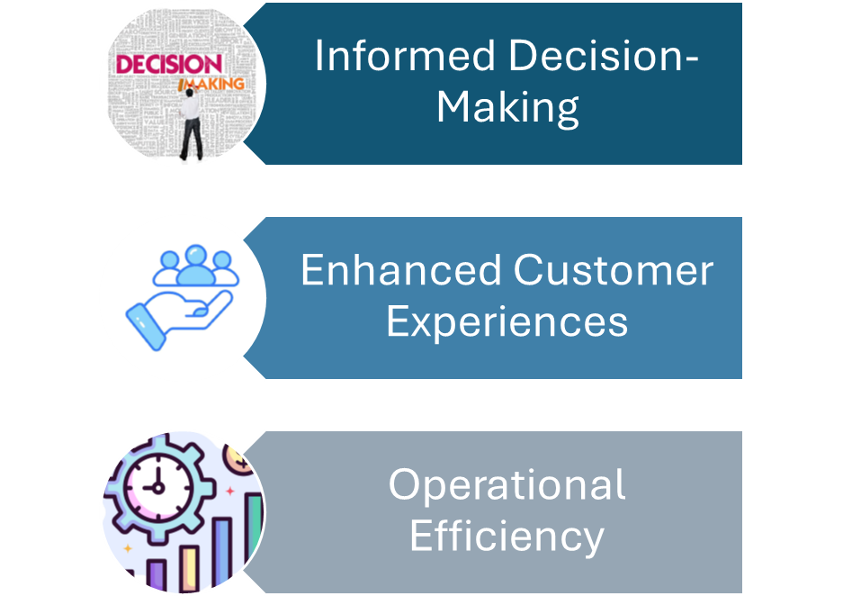
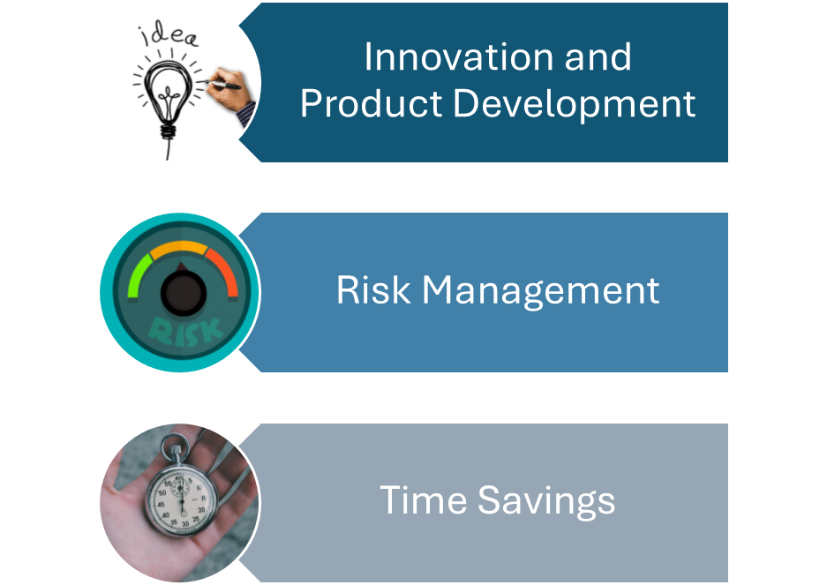

The Strategic Importance of Big Data
Source: https://future-business.org/how-is-big-data-changing-the-way-businesses-operate/
Notes:
7

Slide 8
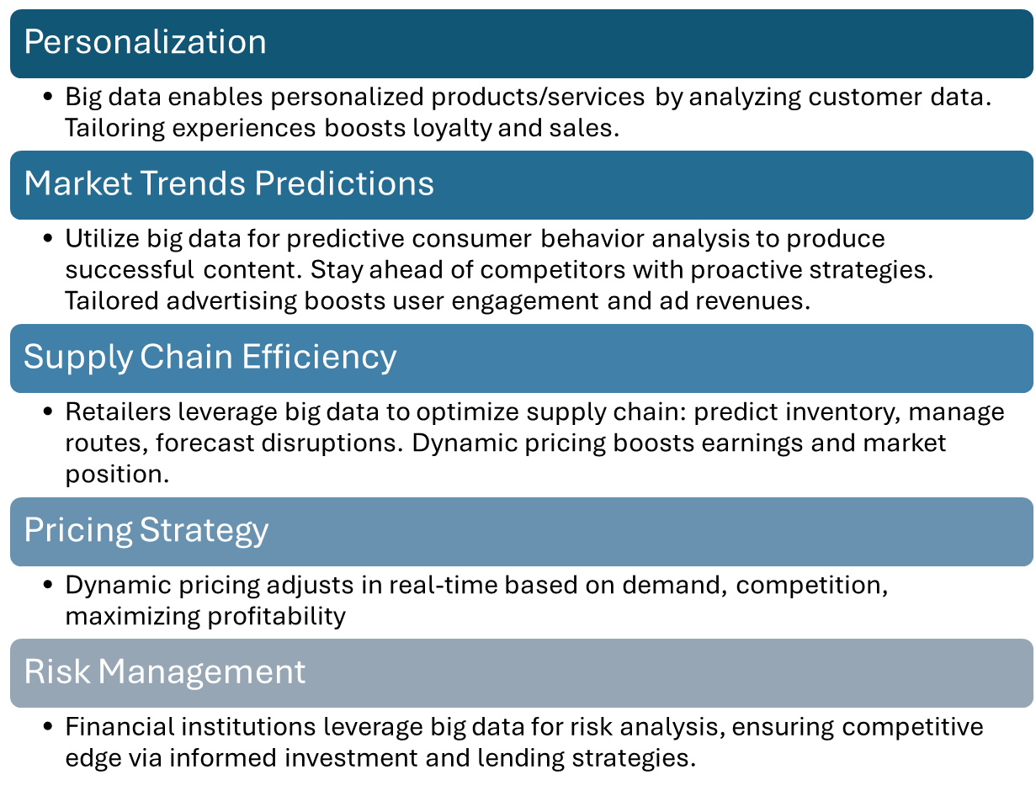
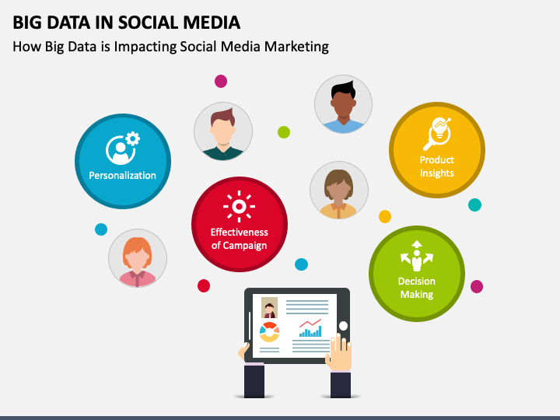
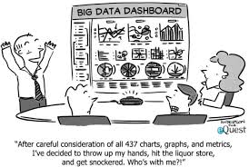
Competitive Advantage with Big Data
Notes:
8

Slide 9
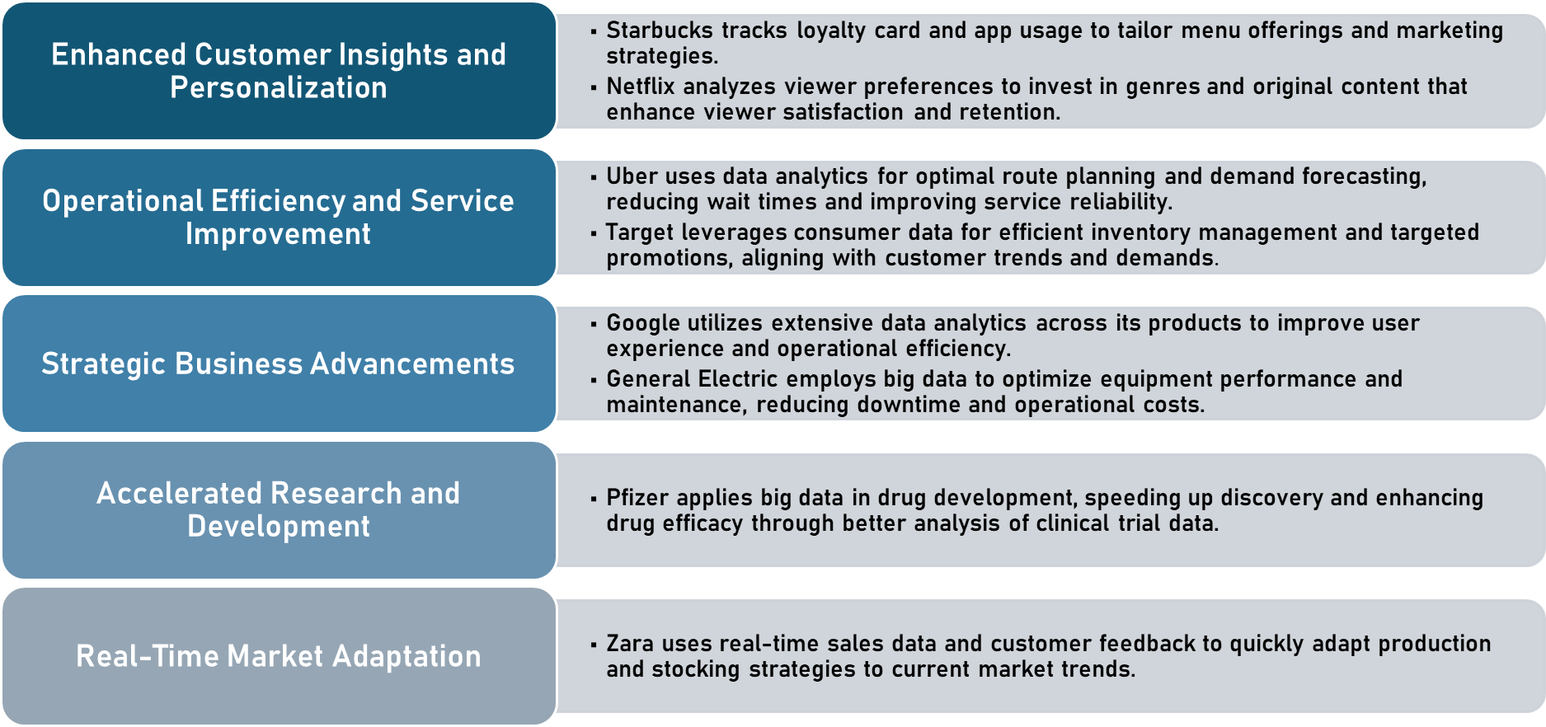
Big Data Enhancing Decision-Making
Notes:
9

Slide 10
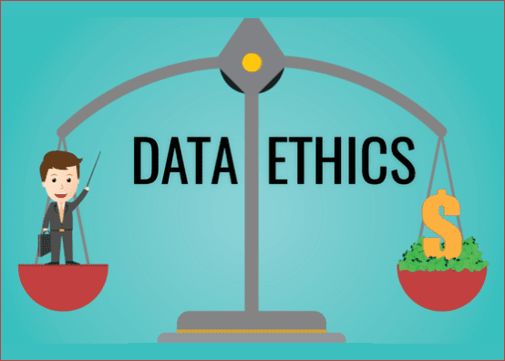
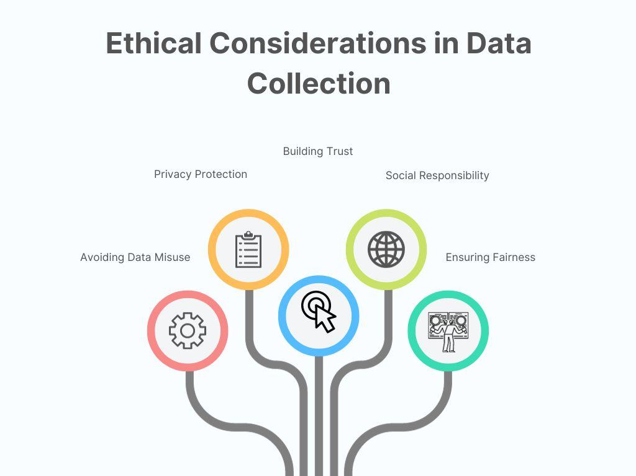
Ethical Considerations:
What is Big Data Ethics?
In today's world, which is heavily influenced by data, Big Data ethics refers to the ethical principles that guide the moral and responsible collection, analysis, and processing of large amounts of data.
In Big Data the main aspects of ethical considerations are Individual privacy, Security, Discrimination and Bias, Ownership, Transparency, Reputation, and Societal impacts of data-related Decisions.
Notes:
10

Slide 11
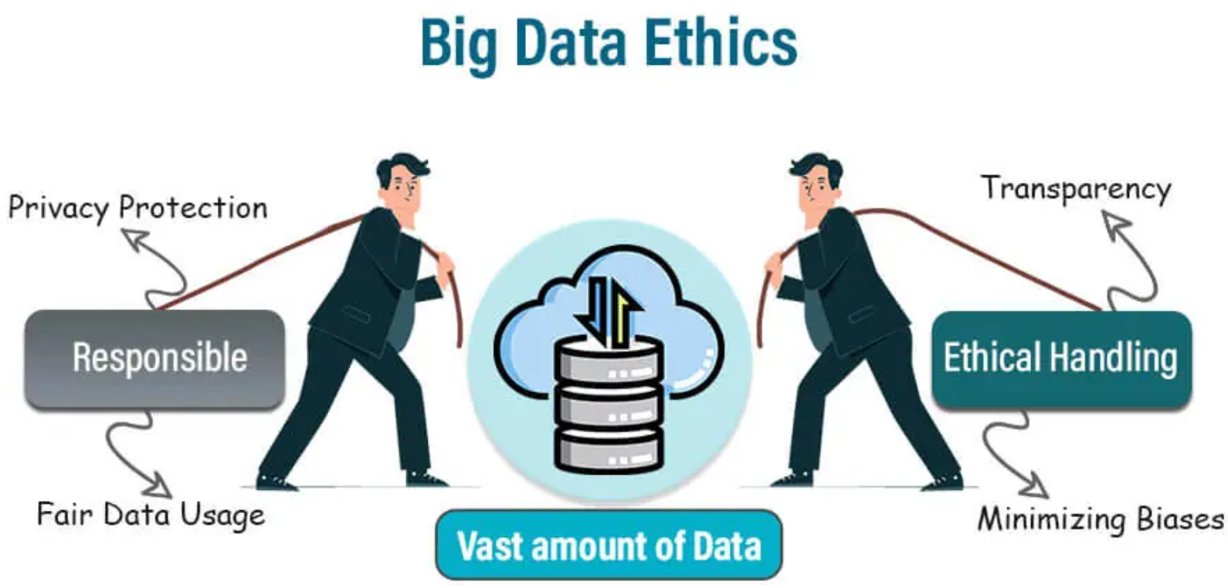
Why are there ethical violations due to Big Data?
The overwhelming amount of big data makes it difficult to protect and the encryption and data protection is not enough. This insufficient protection of data giver rise to an ethical violation as it affects more than mere security concerns security.
Key Measures for ensuring Ethical Big Data Analytics:
Improved Data Governance:, Data protection with regulations such as GDPR
Improved Data Security Measures: Enhanced and Secure Data Storage and Encryption
Transparency and fair practices in Algorithms of the Organization.
Ethical AI and responsible Data-handling practices

Slide 12
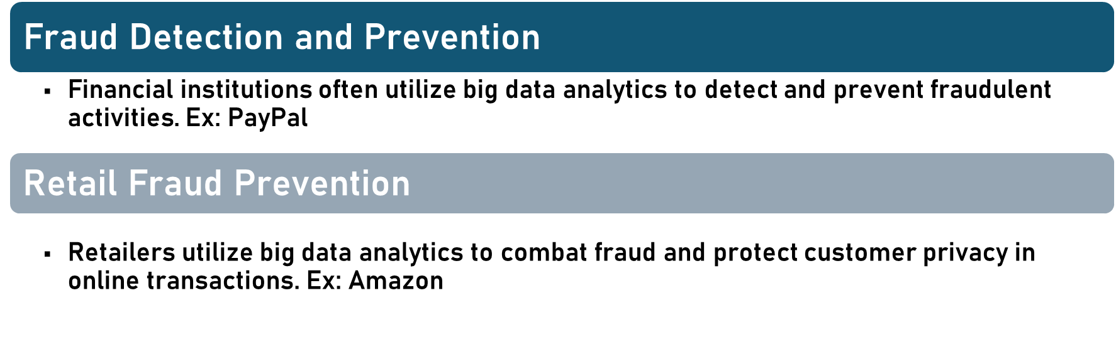
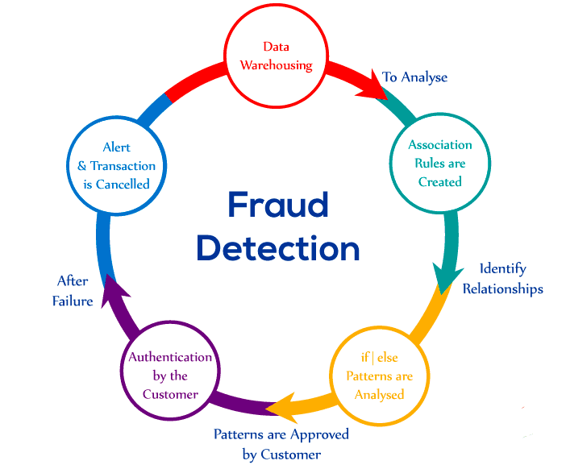
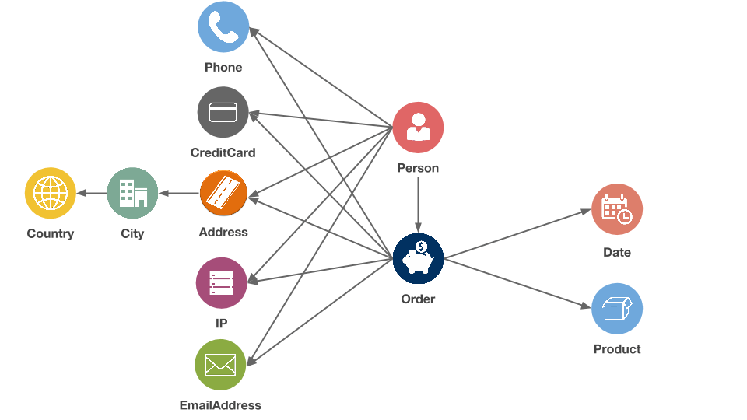
Positive Ethical Implications of Big data

Slide 13
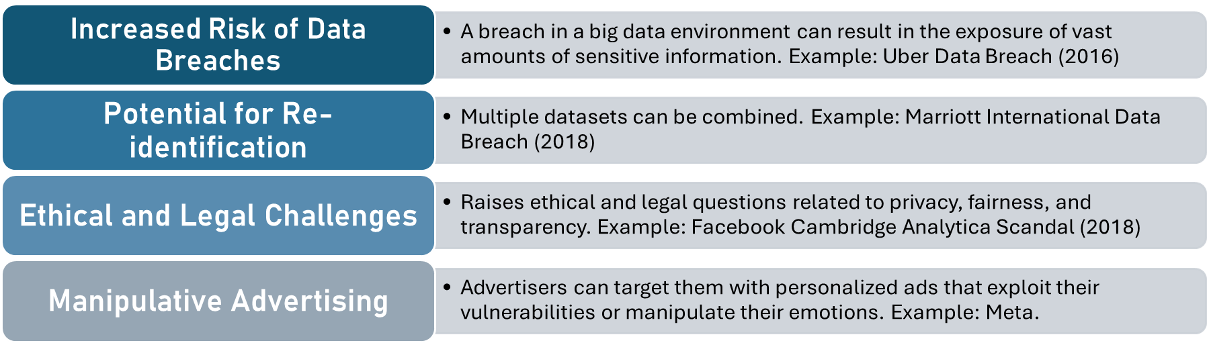

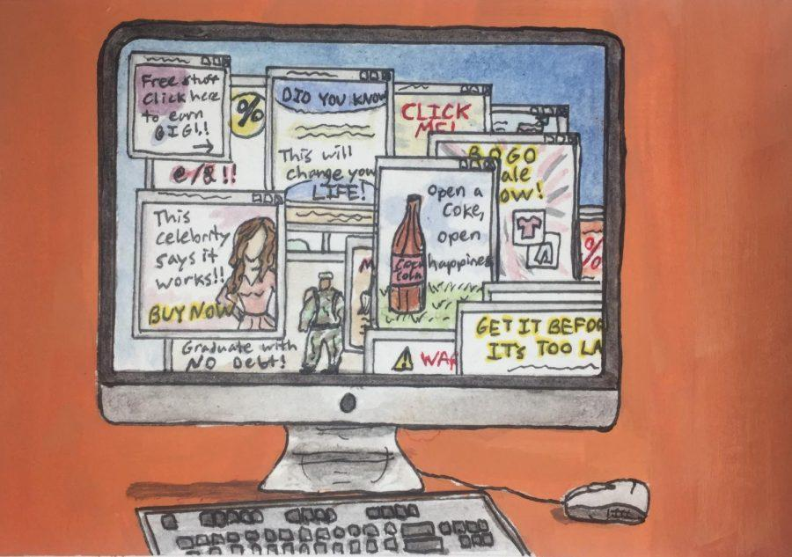
Negative Ethical Implications

Slide 14
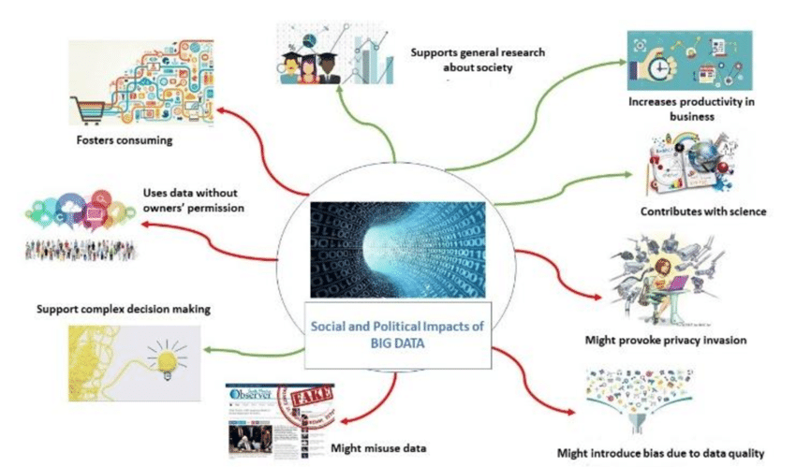
Social Impact of Big Data
The intersection of ethics and big data carries significant social implications. As new ethical guidelines emerge to promote responsible use of big data by organizations and individuals, it becomes evident that there are social ramifications, as evidenced by social impact theory.

Slide 15
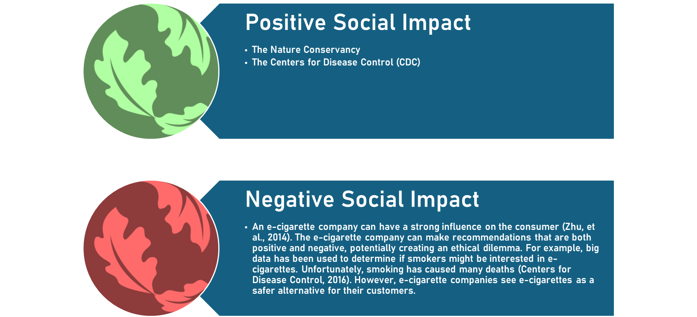
The Nature Conservancy (NGO): By examining satellite images and other data, the organization has successfully pinpointed regions that are highly susceptible to deforestation. The Centers for Disease Control (CDC): Uses Big data to predicts and reviews the spread of flu and when it can outbreak.
An example of an E-cigarette company: Uses big data to recommend products to consumers, however, should be careful as the promotion of negative problems causes ethical and sensitivity problems.
Notes:
15

Slide 16
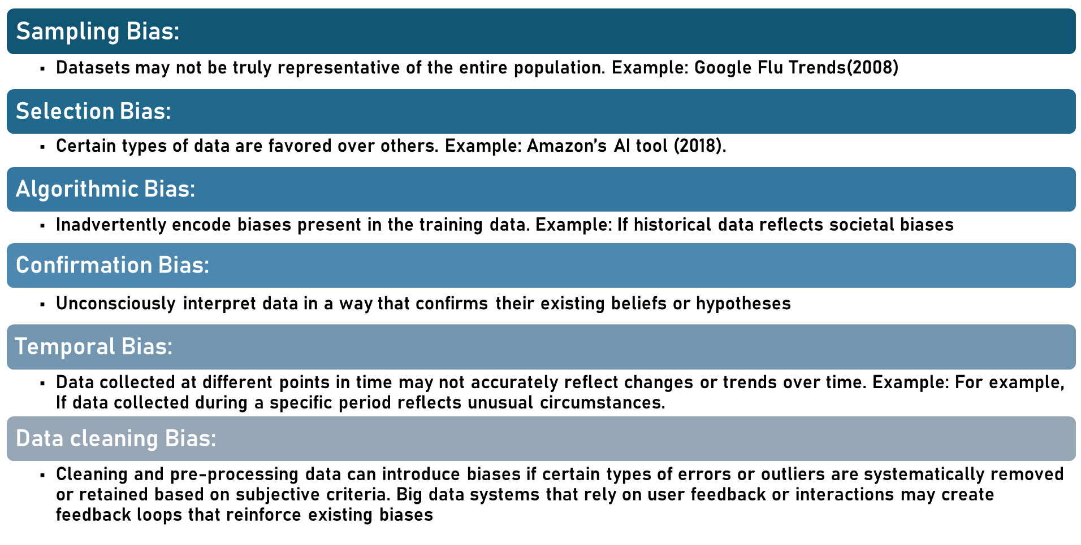
Potential Biases

Slide 17
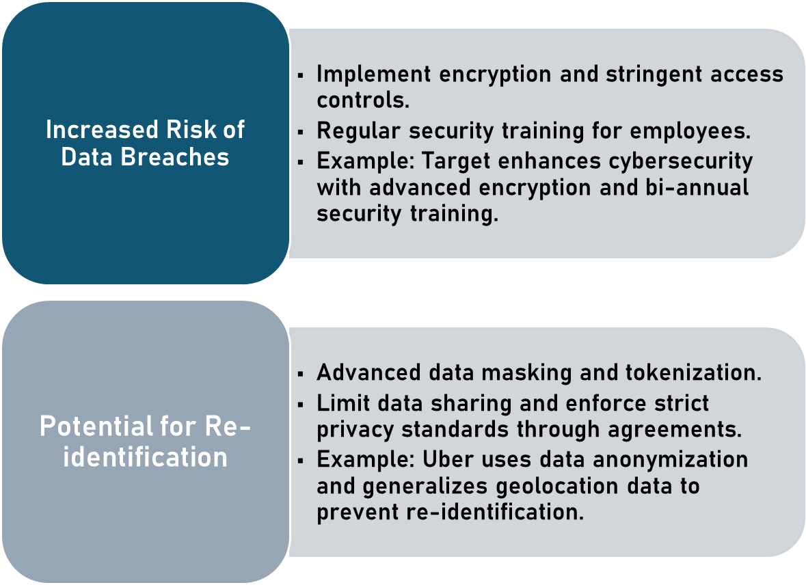
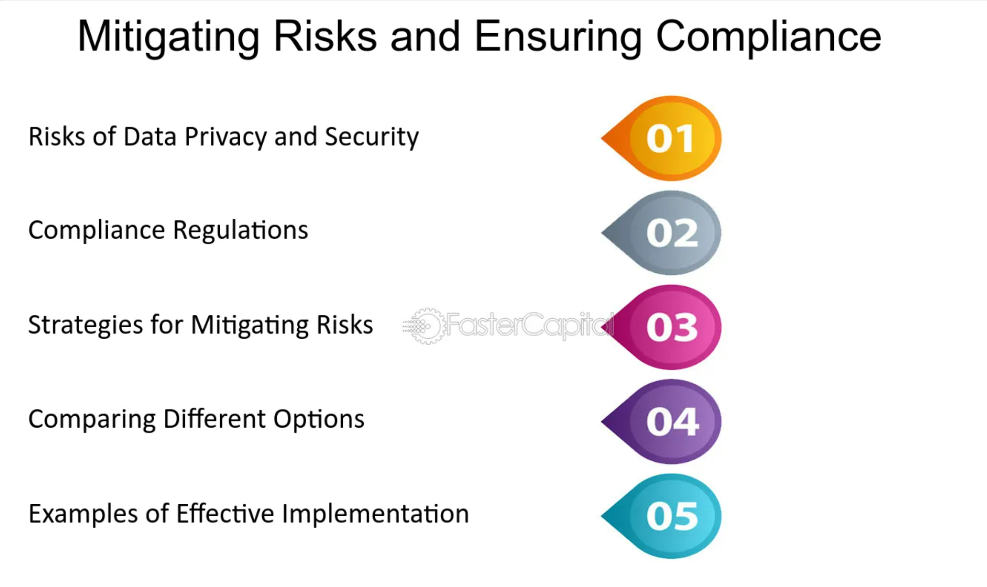
Mitigating Ethical Issues

Slide 18
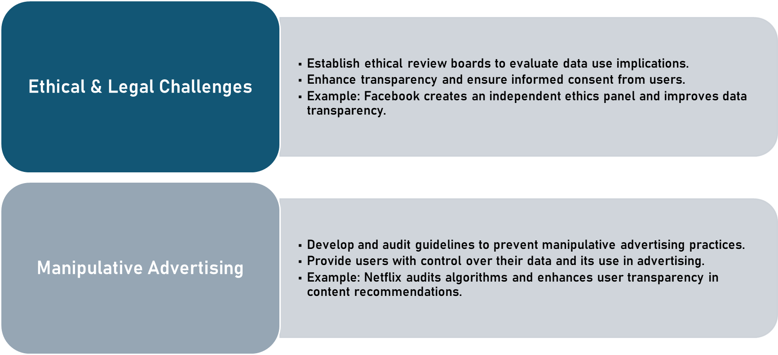
Mitigating Ethical Issues

Slide 19
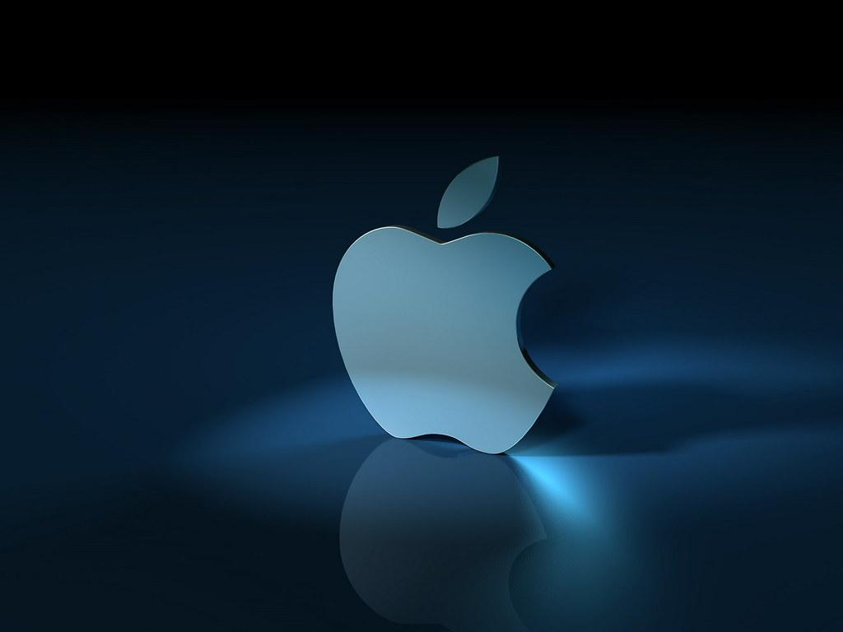
Apple's approach to mitigate Big data ethical issue
Apple has implemented several measures to address ethical issues related to big data and enhance user privacy around their iOS 14 update. The following summaries Apple's main efforts to accomplish each of these objectives:
Transparency in Data Usage
Reducing Data Collection for Advertisements
Enhancing User Awareness and Control
Promoting Data Security
Advocating for Privacy as a Core Value
User Consent for Data Collection

Slide 20

Target's approach to mitigate Big data ethical issue
Centralized Data Governance
Integration of Data Science within Business Units
Data Science and Engineering Team Structure
Transparent and Ethical Use of Data
Promotion of Agile Development and Iterative Testing

Slide 21
Conclusion
Big Data plays a key role in several industries, as it enhances the decision-making process, optimizes operational efficiency, and enhances client experiences.
Ethical challenges such as security breaches, data privacy, and integrity are crucial. Addressing these challenges is essential for appropriate data management. Big Data also has Social Impact encompassing both positive and negative influence.
Enforcing rigorous data governance and security measures is pivotal to protecting data and maintaining trust.
Companies like Apple and Target demonstrate effective strategies in managing ethical issues in Big Data, serving as benchmarks for industry practices.
Adopting ethical Big Data practices is not just about adhering to regulations, but
also about cultivating a sustainable and reliable digital environment for the future
advancement
advancements.

Slide 22
References
https://link.springer.com/article/10.1007/s00146-021-01262-5
https://www.hbs.edu/faculty/Pages/item.aspx?num=53361
Thorbecke C (2021) What to know about Apple's new privacy update and why it's riling Facebook. ABC News. Retrieved from https:// abcnews.go.com/Business/apples-privacy-update-riling-facebook/ story?id=77340719. Accessed 23 Aug 2021
Purtill J (2021) Apple’s iPhone has a new privacy feature that Facebook has tried to stop. ABC News. Retrieved from: https://www.abc. net.au/news/science/2021-04-29/apple-iphone-tracking-operatingsystem-update-facebook-privacy/100100172. Accessed 23 Aug 2021

